Slide 1
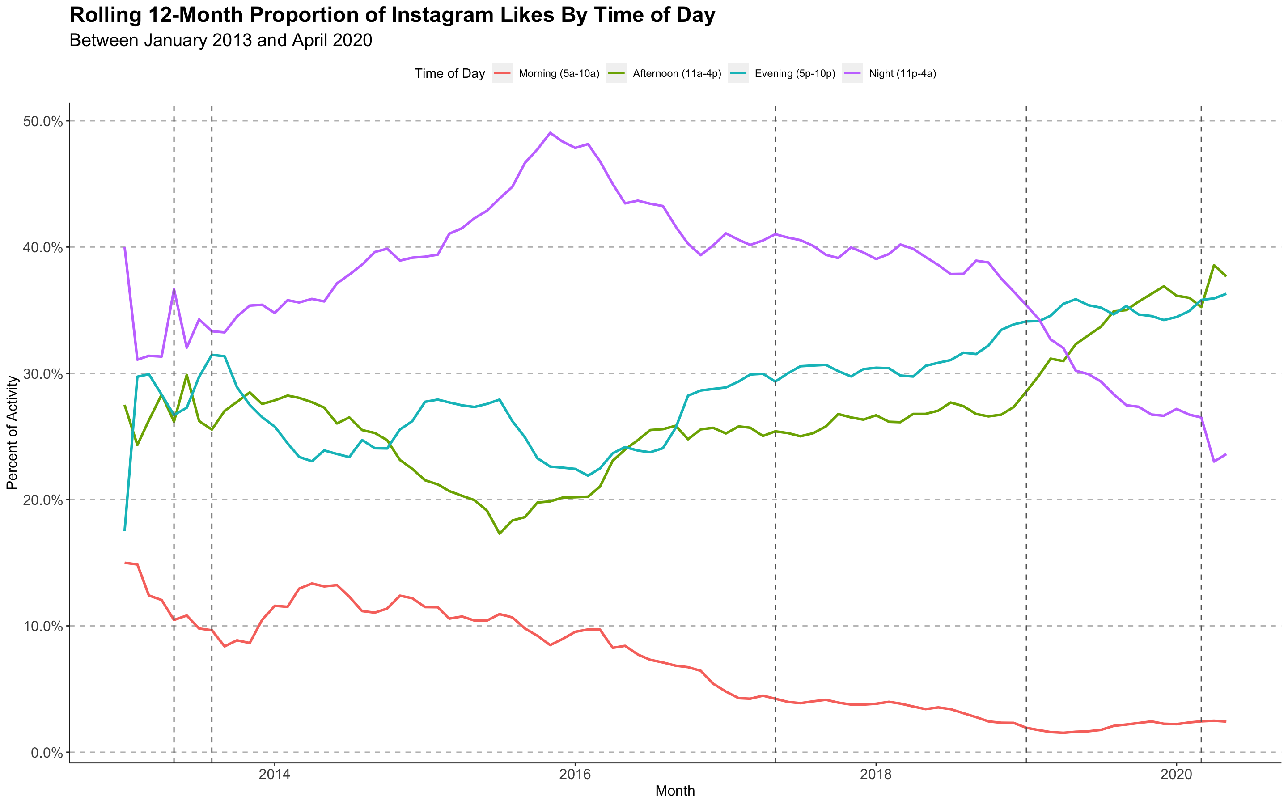
Finished
High School
Started
College
Finished
College
Moved to
Des Moines
Pandemic

Slide 2
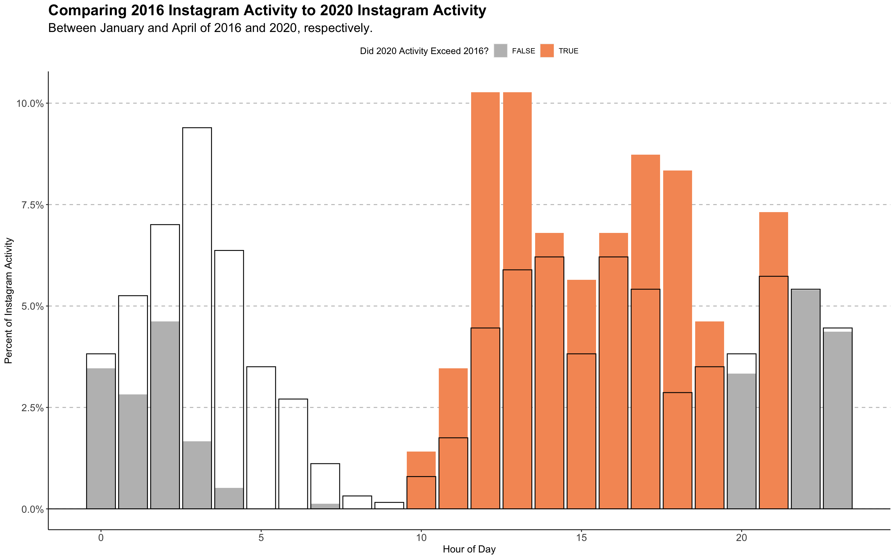
2016 activity
There is a huge increase in activity
during lunch between 12-1
2020 activity

Slide 3
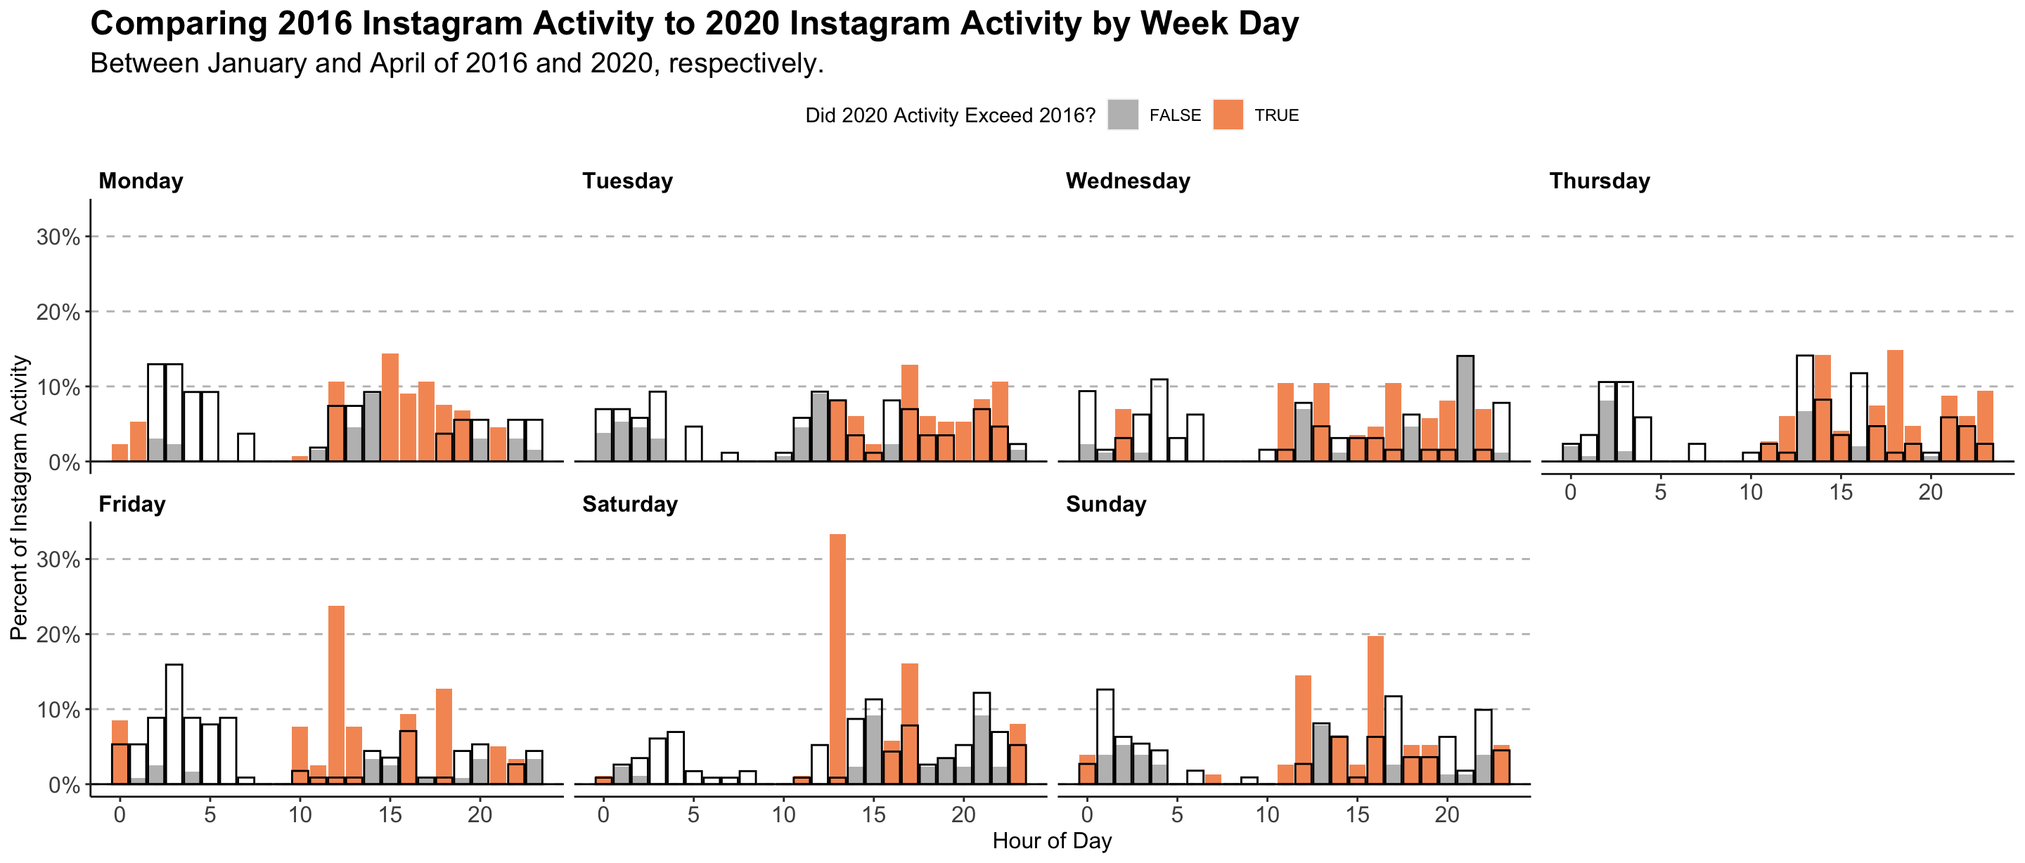
2016 activity
2020 activity

